Slide 1
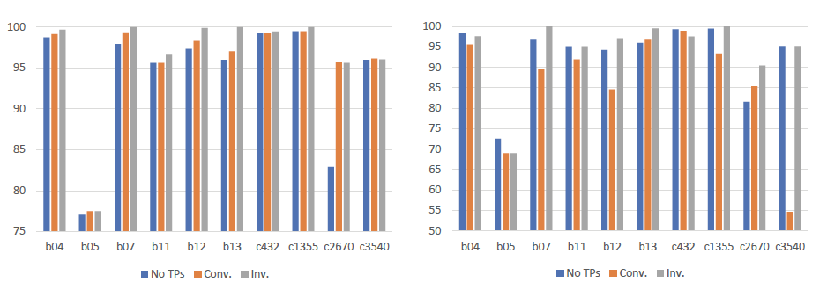
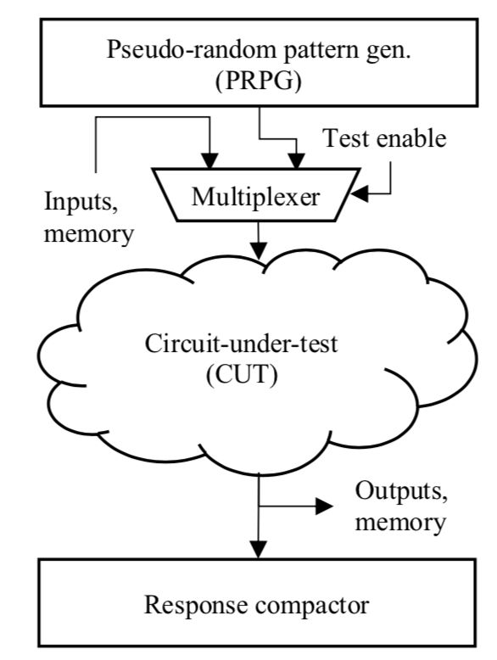
Improved Random Pattern Delay Fault Coverage Using Inversion Test Points Soham Roy, Brandon Steine, Spencer Millican, Vishwani Agrawal Dept. of Electrical and Computer Engineering, Auburn University Auburn Research Student Symposium 2019, 04/09/2019
Motivation
Conventional TP Architectures
Test Point Insertion Method
Circuit test: A critical part of the integrated circuit (IC) manufacturing process.
Pseudo-random testing: Effective for detecting defects in previous generations of technology, but it’s utility is degraded.
Test point insertion (TPI) developed to improve pseudo-random tests.
Effectiveness of inversion-based test points (TPs) in lieu of traditional TPs by analyzing the delay and stuck-at fault coverage, which has not been examined by earlier studies on inversion TPs, is studied.
This study does not propose a new TPI algorithm, and instead will use an established TPI algorithm.
(H.-C. Tsai, K.-T. Cheng, C.-J. Lin and S. Bhawmik. A hybrid algorithm for * Test Point Selection for Scan-based BIST.* Proc. of 34th Design Automation Conference, pages 478-483,1997.).
Algorithms use controllability and observability program (COP) to find the TP which maximizes fault coverage by calculating probability that each fault will be detected, depending on stuck-at 0 or stuck-at 1 fault model.
Using industrial tools was infeasible since such tools are not programmed to give optimal inversion TP placement and would give favorable result towards conventional control TPs.
The purpose of a TP is to make the excitation of faults and the observation of faults more likely under random stimulus.
Pseudo-Random Testing
Inversion-Based TP Architecture
Results & Discussion
Inversion TPs change signal value probabilities through inversions as opposed to forcing circuit lines to predetermined values.
Inversion TPs excite both stuck-at 0 and stuck-at 1 faults when active.
Inversion TPs excite and propagate delay faults when active.
Inversion TPs may falter when a random signal needs to be less random.
Stuck-at and transition delay fault coverage for ITC’99 and ISCAS’85 benchmarks.
The conventional architecture decreases delay fault coverage significantly.

